Slide 1
DYNAMIC PROGRAMMING
Shortest Path in DAGs & Longest Increasing Subsequence

Slide 2
Greedy Algorithms (Review)
Minimum Spanning Tree
Activity Selection
Huffman Codes
Set Cover & Approximation
Today: New Topic (Dynamic Programming)

Slide 3
SHORTEST PATH
In Directed Acyclic Graph

Slide 4
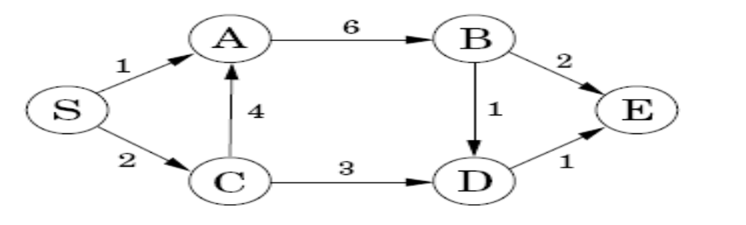
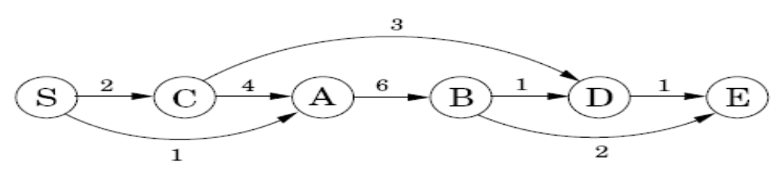
TOPOLOGICAL SORTING

Slide 5
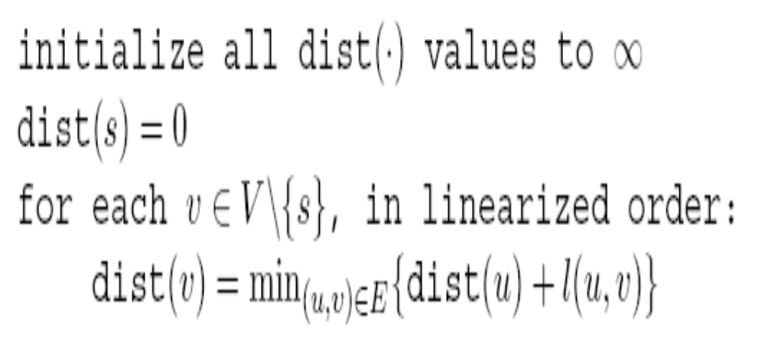
Dist (far-nodes) From Dist (near-nodes)

Slide 6
WHAT ABOUT …
Longest Path in DAGs ?

Slide 7
Dynamic Programming
… is “just” a DAG of sub-problems!

Slide 8
LONGEST INCREASING SUBSEQUENCE (LIS)
Our next example

Slide 9
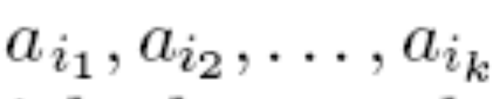
The Problem
A subsequence is:
an increasing subsequence is one in which the numbers are getting strictly larger
The task is to find the increasing subsequence of greatest length

Slide 10
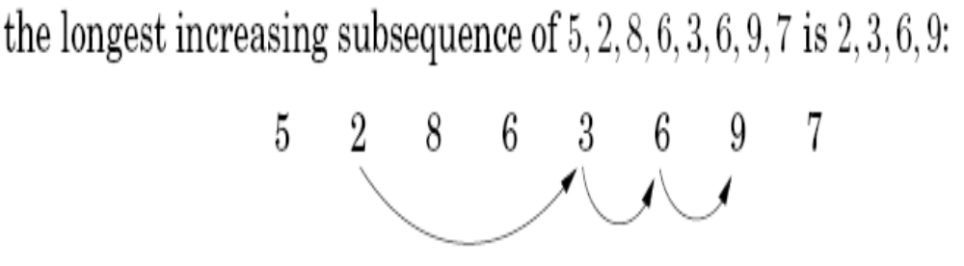
An Example

Slide 11
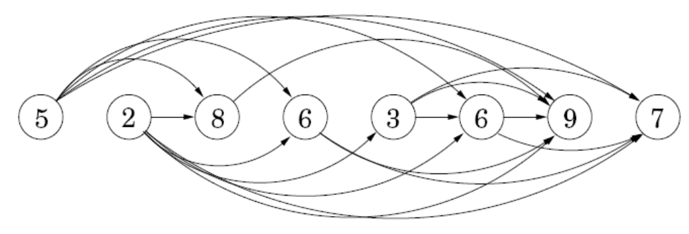
Let's create a graph of all permissible transitions:
establish a node i for each element a_{i}, and add directed edges (i, j) whenever it is possible for a_{i} and a_{j} to be consecutive elements in an increasing subsequence, that is, whenever i < j and a_{i} < a_{j}

Slide 12
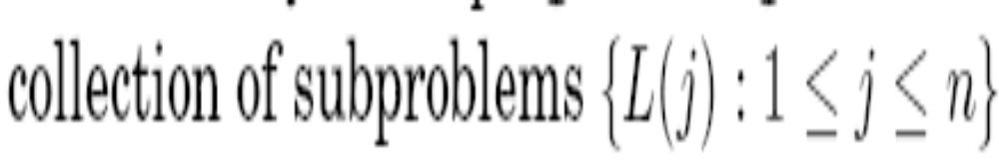
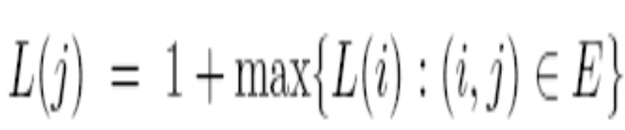
What Are the DAG of Sub-Problems?
DYNAMIC PROGRAMMING: There is an ordering on the subproblems, and a relation that shows how to solve a subproblem given the answers to smaller subproblems, that is, subproblems that appear earlier in the ordering.

Slide 13
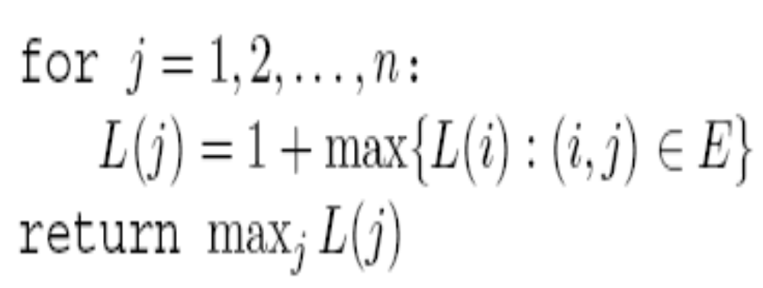
THE ALGORITHM
This algorithm will only give us the length of LIS.To get the path of LIS we need to store the i,j as P[j]=i.So when we need to get the path then we just run in a loop and get the path as follows:
P[j]=i -> P[i]=k -> P[k]=l -> .... and so on till we reach an end.

Slide 14
THANK YOU
Any Questions?
SUMMARY:
Dynamic Programming as a DAG of sub-problems
Example #1: Shortest/Longest path in DAGs
Example #2: Longest Increasing Subsequence

